Slide 1

Teaching Resources and Instructors’ Guidelines
Chapter 2: Digital is different?

Slide 2
Chapter 2: Digital is different?
In the following PowerPoint slides you will find the key headings from CHAPTER 2 together with the main illustrations, tables, etc.
There are also slides summarizing the key messages in bullet-point fashion, and a wide range of activities which you can use to help students explore around these themes.
Finally there are some reflection questions which can be used as the basis for discussion or assignments.

Slide 3
Learning Objectives
By the end of this chapter you will have an understanding of:
The nature and origins of digital innovation
The case for seeing it as a transformative technology with pervasive impacts across all sectors
The role it can play in innovation management by providing powerful new tools to support the process
The wider management implications, especially in learning to operate at a system level

Slide 4

Core themes and material from the book

Slide 5
Digital innovation…
….the suite of technologies around the creation or capture, storage/retrieval, processing and communication of information and their combination into high level systems with emergent properties.

Slide 6
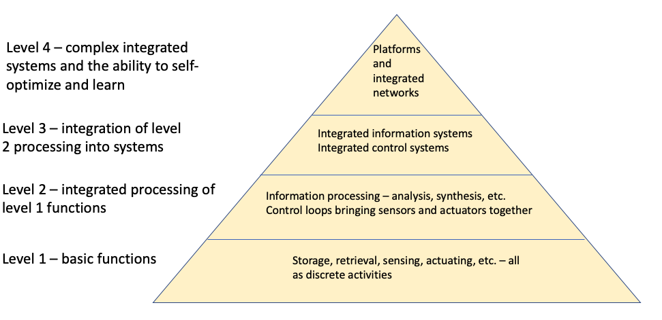
Simplified model of digital innovation

Slide 7


Is it new?

Slide 8

Is it revolutionary?

Slide 9
Key features of digital technologies
Low cost leading to widespread application potential
Common language – digital code – enabling communication and interoperability of software
Fast easy communication - connectivity was the barrier back in the 1980s, even with advanced protocols like ISDN (Integrated Services Digital Network) and similar.
Increasing wireless connection potential
Low cost enables intelligent functionality to be built into the simples of devices and then connected into systems – the ‘internet of things’
Learning via machine (artificial intelligence)
Potential to collect and work with Big Data – massive increases in the volume, variety and velocity of collection allows for pattern recognition and exploiting of network-level effects

Slide 10
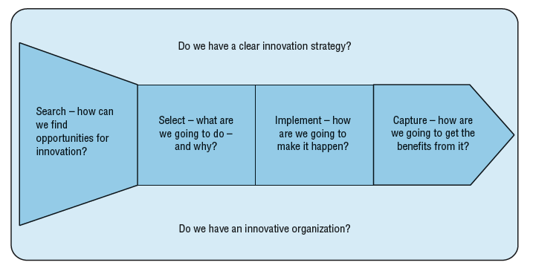
What does it mean for innovation management?

Slide 11
The new digital toolkit
Stage in innovation process | Digital tools
Search | Broadcast search / crowdsourcing Cross-sector pattern matching Patent mining Innovation contests Innovation markets User communities Netnography Internal collaboration platforms

Slide 12
The new digital toolkit
Implement | Simulation and prototyping tools – e.g. 3D printing Collaboration platforms Co-creation communities Virtual teams AI/machine learning

Slide 13
The new digital toolkit
Select | Idea markets Voting via collaboration platforms Crowdfunding Decision support tools Machine learning/artificial intelligence (AI) applied as decision tool Simulation and prototyping to extend the exploration phase at low cost

Slide 14
The new digital toolkit
Capture value | Networking and viral marketing to accelerate diffusion Platform models to concentrate and deploy knowledge Ecosystem construction AI/machine learning

Slide 15
Front-end innovation tools
Innovation contests and crowdsourcing solutions
Innovation markets
Innovation communities
Innovation toolkits
Innovation laboratories, makerspaces, collective co-creation

Slide 16
Collaborative innovation platforms
Finding ideas – crowdsourcing, broadcast search
Selecting ideas – idea markets, comments and collaboration
Implementing ideas – on and offline support for development and collaboration
Targeting innovation – via campaigns and missions
Knowledge management – capture, sharing, recombination

Slide 17
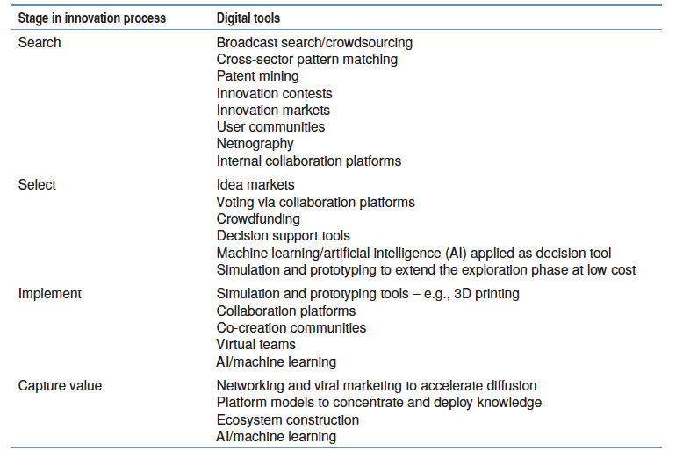
Digital tools across the innovation process

Slide 18
Driving new approaches to innovation management
Systems level thinking
Platform thinking
Changing role of knowledge
Skills and capabilities
Responsible innovation

Slide 19
Summary
In this chapter we have explored the potential of digital innovation, defined as the suite of technologies around the creation or capture, storage/retrieval, processing and communication of information and their combination into high level systems with emergent properties.
We have seen that although not new the momentum behind this technological wave has been building and has reached a maturity in development of key components and infrastructure that now enables system level solutions to be widely available across all spheres of social and economic activity
Such a trend and the accompanying emergent properties of such systems qualify digital innovation for being considered as transformative, having many characteristics associated with long waves of economic and social change

Slide 20
Summary
Digital innovation has two key implications for innovation management. First in the outputs of the innovation system; there is enormous scope for applying the technology and the challenge is to explore innovation space as effectively as possible to find and exploit these opportunities. At the same time the take-up of the technologies is limited by the availability of skills, structures and business models to enable them and so building these into digital innovation strategies will be important.
In terms of its implications for the process of innovation itself digital innovation offers a wide range of new and improved tools with which to work right across the process. Once again this has skills and capability building implications

Slide 21
Summary
There are also new challenges for innovation management emerging from the need to learn to operate at system level, co-ordinating and orchestrating the efforts of multiple actors and stakeholders in wider innovation ecosystems
The transformative potential of digital innovation raises questions about the purposes and consequences of such a trajectory and this underlines the need for a ‘responsible innovation’ approach

Slide 22

Videos
There are several videos which can help explore and present the key themes of the chapter:
David Simoes Brown of 100% Open talking about the challenges of working in open innovation with especial emphasis on digital channels
Catharina van Delden talking about her company Innosabi which has grown to be a successful business in the field of online community development to support agile innovation
Michael Bartl talking about using digital tools for market research
Pedro Oliveira talking about Patient Innovation, a healthcare innovation platform
Francisco Pinheiro, Strategic Innovation Manager with Atos talking about the challenges of getting innovative ideas from employees via internal online platforms in the company
Notes:
Short videos

Slide 23
Blogs and podcasts
There are several podcasts and blogs picking up key themes around managing innovation as a process and some of the key variables:
Birth of the internet
An innovation birthday party
Alan Brown also has an excellent blog on digital innovation here

Slide 24
Cases
There are several case studies on the website which highlight key themes in the chapter, including:
Lufthansa Systems and Liberty Global showing how they use collaboration platforms to search for ideas across the organization
Procter & Gamble’s ‘connect and develop’ search approach
Cash programming in humanitarian innovation showing the massive potential for digital approaches
Hella, showing how the move into digital technologies in the 1980s transformed the fortunes of the business
Lego, Threadless, Zara showing how digital techniques enabled major new innovation directions
Report on ‘open collective innovation’
Report on opening up healthcare innovation
Cybercrime report

Slide 25
Tools
There is a rich variety of tools to help with innovation and many of these have been significantly upgraded through the use of digital approaches. You can find a full list here.

Slide 26
Tools
You can find an interactive e-book and tool here which explores the use of online collaboration platforms to enhance innovation within and between organizations

Slide 27
Activities
There are a variety of activities (for both groups and individuals and for online as well as offline work. These include:

Slide 28
Activities
Look at an organization with which you are familiar or pick one of the cases on the website. How far has (or might) digital technology change the business and how might this affect the way innovation is managed?

Slide 29
Activities
Look at the high involvement maturity model here and then take an organization with which you are familiar and try to position it on the model. Where do you see some of the major challenges in adopting this kind of approach based on digital platforms?

Slide 30
Activities
Look at one of the major innovation platforms now operating – Apple, Amazon, Facebook, Netflix, Alibaba, Yandex, Google, etc.
How has digital innovation played a role in enabling the rapid growth of such organizations?
How far do they depend on owning the assets on their platforms and how far is it a case of managing an ‘ecosystem’?

Slide 31
Assessments
‘Digital innovation is just a case of putting old wine in new bottles – the impact on the way we manage the innovation process is minimal’. Discuss the arguments for and against this point of view.

Slide 32
Assessments and discussion questions
What do you see as the main challenges in developing a strategy for digital innovation?
Is there a risk of a ‘digital divide’ with winners and losers in digital innovation – for example, in the field of healthcare. Research the question and try to illustrate your answer with examples

